Slide 1
GENERAL RULES FOR STAMP ONLINE ISP3
CASE 4

Slide 2
COUNTRY SELECTION
Within one room (UR1, UR3, Aula) each of six groups must choose different country out of the list provided in the case.
First come first served basis works here. When one group loudly express that they are taking country X, other groups must look for another country to choose.
Criterion for country selection is up to you – you choose criterion which will help you to pick a country.

Slide 3
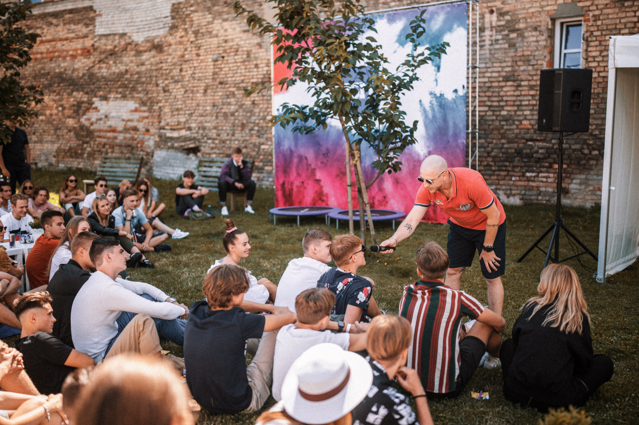
TWO ROUNDS OF PRESENTATIONS
The first round will be in your rooms (UR1, UR3, Aula). Each group presents to supervisors and other student groups. Both grade the presentation. Based on grading the best presentation in the room is selected.
The second round (the best three presentations) will be in Aula.

Slide 4
Presentation rules (I round)
6 min per one group. After 6 min and 5 seconds you are stopped
Bad answer is better than no answer
Clear grounded solutions to the board
No details, just key messages and figures
Lack of time is not an excuse to the chairman of the board ☺

Slide 5
TIMETABLE
Thursday 14.30-16.15*
Country selection and Task 1. If you finish, start Task 2.
* Coffee break 15.30-15.45
Friday 9.00-11.00
Task 2 and presentation drafting
Friday 11.15-12.15
Presentation finalization and presentations within the room (up to 6 mins per group), grading
Friday 12.15-13.15
The best presentations from each room and case summary
Notes:
Tobulas balansas tarp visų trijų – geriausias rezultatas karjeroje. (Noriu būti ekonomistas, galiu būti ekonomistu, rinkai reikia ekonomistų) Jei kažkuris uždominuoja labiau – gaunasi nukrypimas.

Slide 6
Evaluation
Each group and room supervisors has to evaluate each presentation from 0 to 10. One group with the highest evaluation goes to Aula for final presentation.
0-3
0-6
0-1
Solution for Task 1
Solution for Task 2
Pro-bono
questions

Slide 7
Good luck with your solutions!

